Slide 1

Data Poisoning: Attacks and Defenses
姜育刚，马兴军，吴祖煊

Slide 2

Recap: week 5
1. Adversarial Defense
Early Defense Methods
Early Adversarial Training Methods
Advanced Adversarial Training Methods
Remaining Challenges and Recent Progress

Slide 3
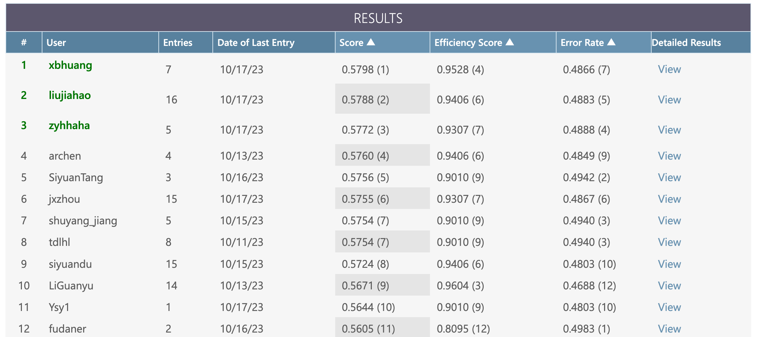
Adversarial Attack Competition
Link: https://codalab.lisn.upsaclay.fr/competitions/15669?secret_key=77cb8986-d5bd-4009-82f0-7dde2e819ff8

Slide 4
Data Poisoning: Attacks and Defenses
A Brief History of Data Poisoning
Data Poisoning Attacks
Data Poisoning Defenses
Poisoning for Data Protection
Future Research

Slide 5
A Recap of the Attack Taxonomy
Attacker’s knowledge
Black-box
White-box
Gray-box
Universality
Individual
Universal
Attack timing
Poisoning attack
Evasion attack
Attacker’s goal
Targeted attack
Untargeted attack

Slide 6
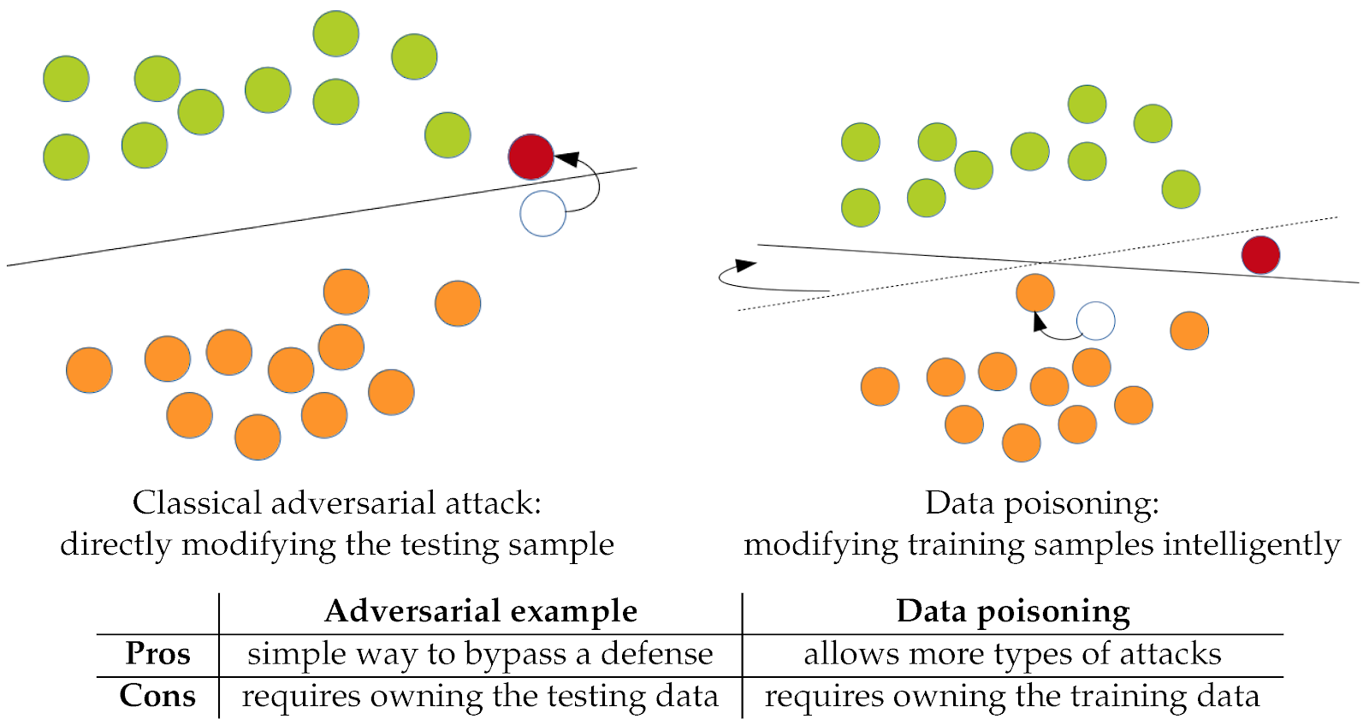
Data Poisoning is Training Time Attack
Evasion (Causation) attack
Test time attack
Change input example
Poisoning attack
Training time attack
Change classification boundary

Slide 7
Data Poisoning: Attacks and Defenses
A Brief History of Data Poisoning
Data Poisoning Attacks
Data Poisoning Defenses
Poisoning for Data Protection
Future Research

Slide 8
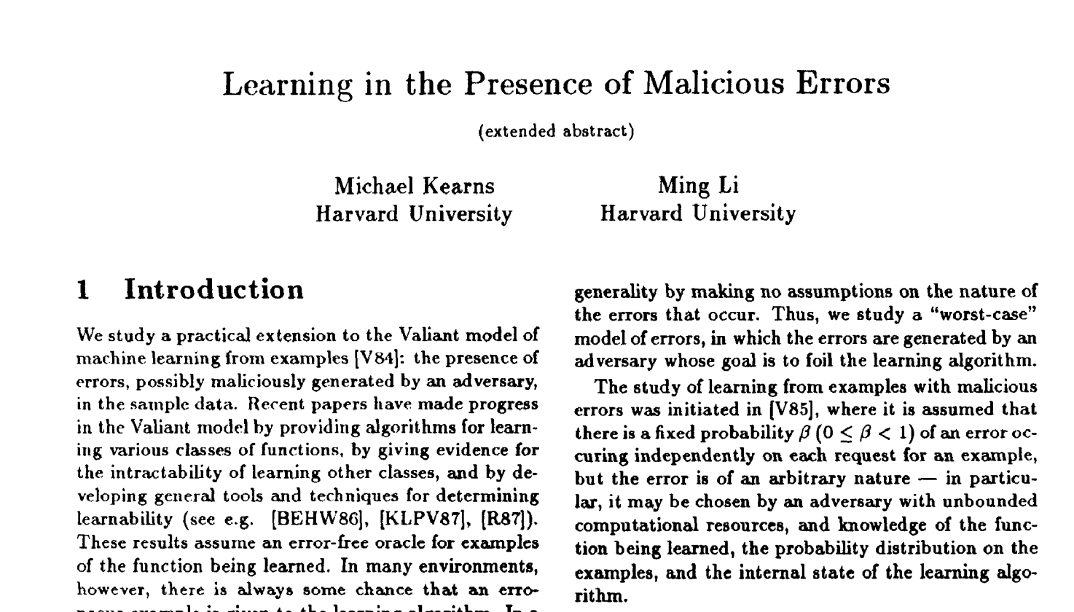
A Brief History: The Eearliest Work
Kearns and Li. “Learning in the presence of malicious errors”, SIAM Journal on Computing, 1993

Slide 9
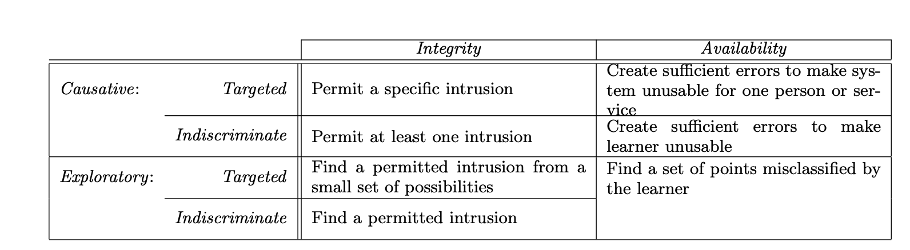
Poisoning Intrusion Detection System
The attack model
Barreno, Marco, et al. “Can machine learning be secure?.” ASIACCS, 2006.

Slide 10
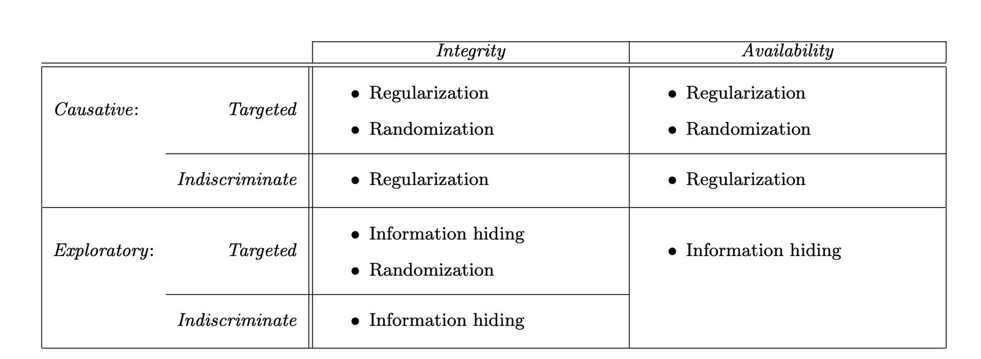
Poisoning Intrusion Detection System
The defense model
Barreno, Marco, et al. “Can machine learning be secure?.” ASIACCS, 2006.

Slide 11
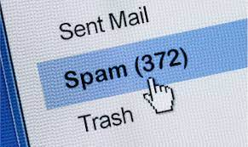
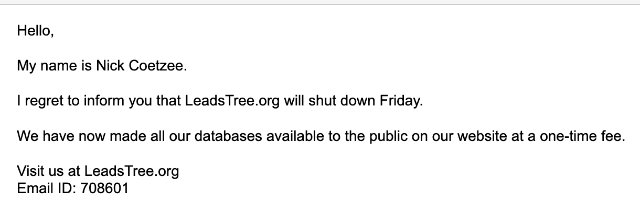
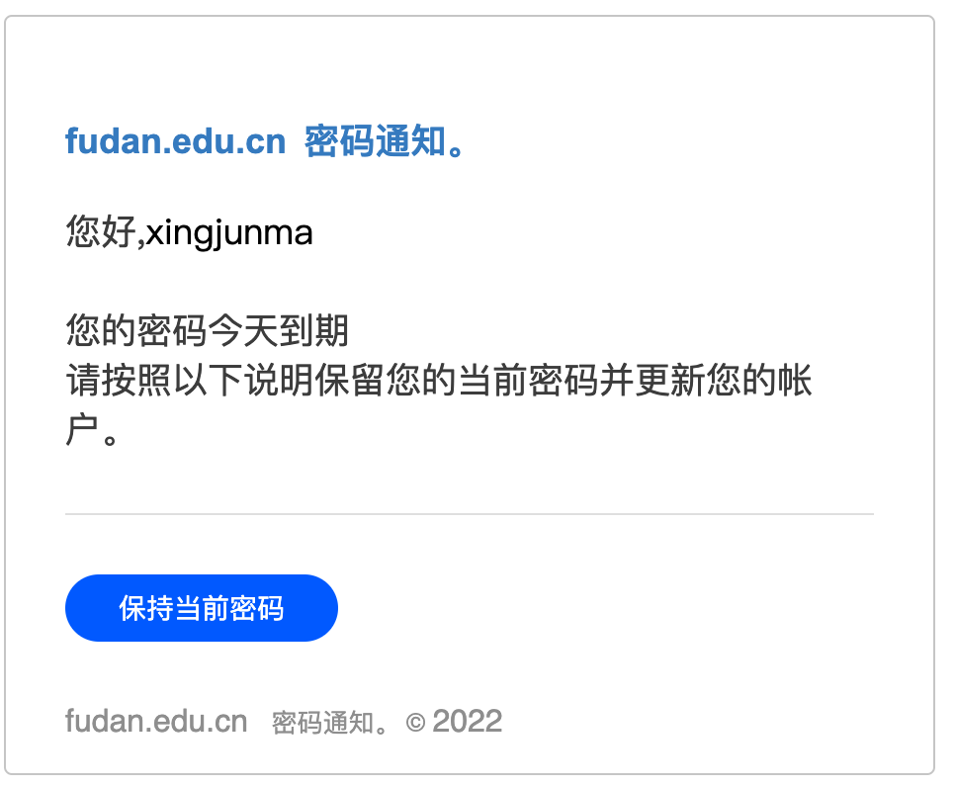
Subvert Your Spam Filter
Usenet dictionary attack:
Add legitimate words into spam emails
1% poisoning can subvert a spam filter
Nelson, Blaine, et al. "Exploiting machine learning to subvert your spam filter." LEET 8.1 (2008): 9.

Slide 12
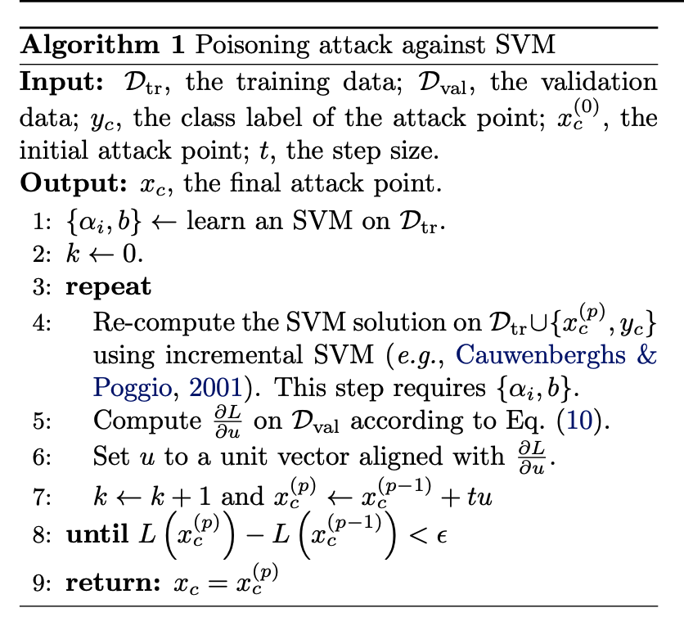
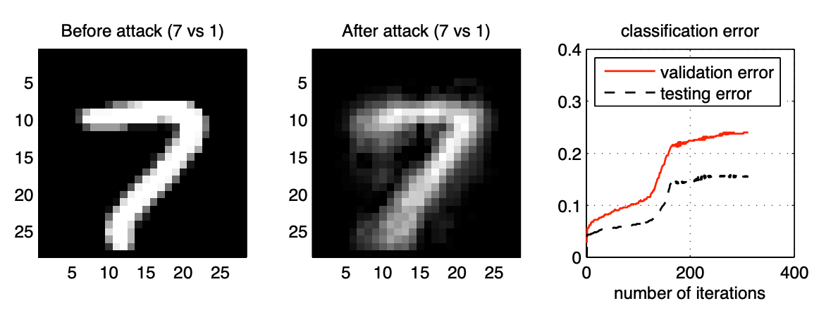
The Concept of Poisoning Attack
a single attack data point caused the classification error to rise from the initial error rates of 2–5% to 15–20%
Biggio, Nelson and Laskov. "Poisoning attacks against support vector machines."arXiv:1206.6389 (2012).

Slide 13
Data Poisoning: Attacks and Defenses
A Brief History of Data Poisoning
Data Poisoning Attacks
Data Poisoning Defenses
Poisoning for Data Protection
Future Research

Slide 14
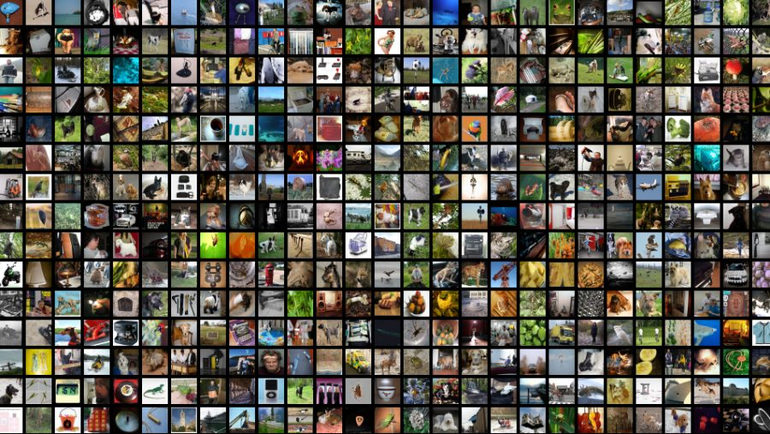


Attack Pipeline
模型训练
污染少量训练样本（越少越好）
无效模型、被控制模型
投毒攻击 != 后门攻击
后门攻击的一种实现方式是通过数据投毒

Slide 15
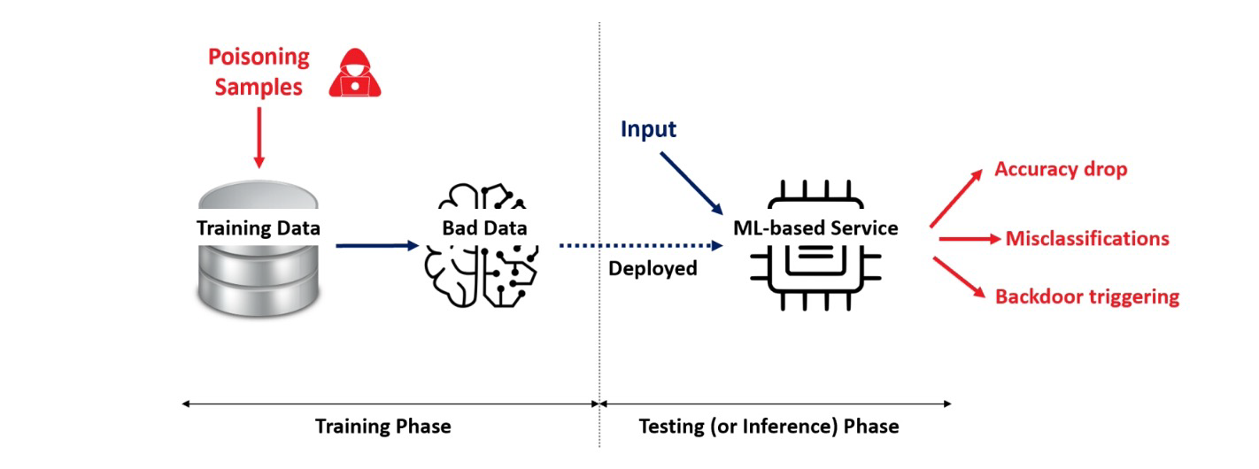
Attack Pipeline
Liu, Ximeng, et al. "Privacy and security issues in deep learning: A survey." IEEE Access 9 (2020): 4566-4593.

Slide 16
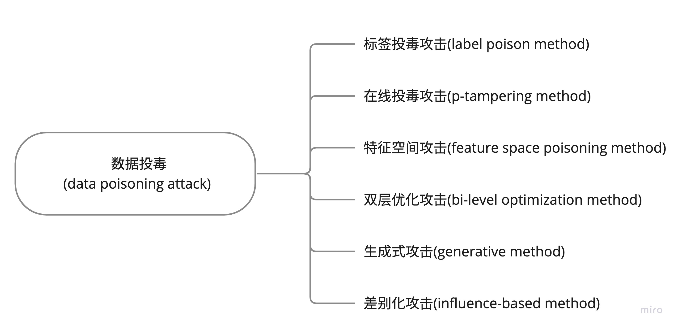
Attack Types
Core idea: how to influence the training process

Slide 17
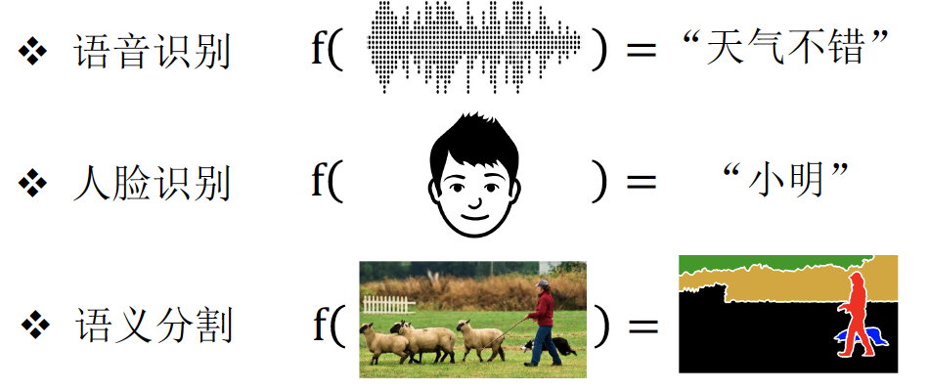
Label Poisoning
Label Flipping Attack （“指鹿为马”攻击）
Random Labels
Label Flipping
Partial Label Flipping
Self-supervised learning?
Incorrect labels break supervised Learning!
Biggio, Nelson and Laskov. "Poisoning attacks against support vector machines."arXiv:1206.6389 (2012).
Zhang and Zhu. "A game-theoretic analysis of label flipping attacks on distributed support vector machines." CISS, 2017.

Slide 18
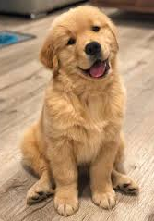
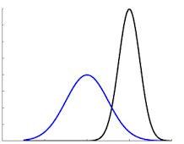
p-tampering attacks
篡改攻击（“暗度陈仓”攻击）
投毒？
Pr=0.8
在线更新模型
‘dog’
‘dog’
induces bias shift
Mahloujifar and Mahmoody. “Blockwise p-tampering attacks on cryptographic primitives, extractors, and learners.” TCC, 2017.
Mahloujifar, Mahmoody and Mohammed. "Universal multi-party poisoning attacks." ICML, 2019.

Slide 19
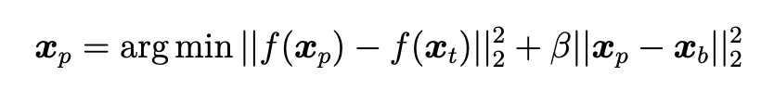
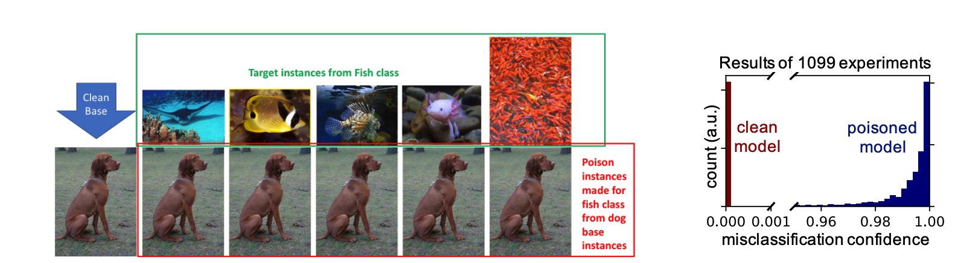
Feature Space Poisoning
Feature Collision Attack （“声东击西”攻击）
A white-box data poisoning method
Feature flipping, does not change labels
优缺点：
需要知道目标模型
对迁移学习很强
对从头训练并不强
看上去是’狗’，但是在特征空间是’鱼’
Shafahi, Ali, et al. “Poison frogs! targeted clean-label poisoning attacks on neural networks.” NeurIPS 2018.

Slide 20
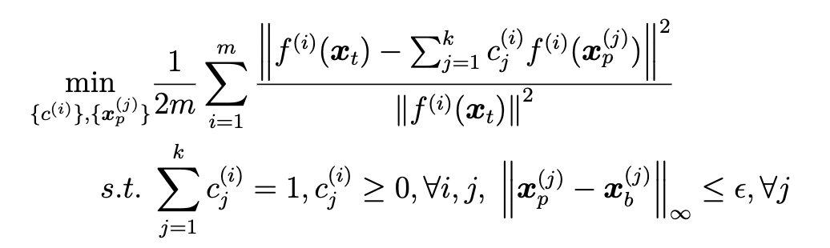
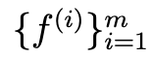
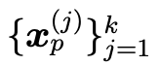
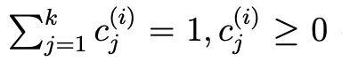
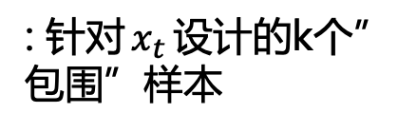
Convex Polytope Attack
凸多面体攻击（“四面楚歌”攻击）
Improve the transferability to different DNNs
寻找一组毒化样本将目标样本包围在一个凸包内
借助多个预训练模型来寻找“包围”样本
: m个预训练模型
: 针对$x_{t}$设计的k个”包围”样本
权重约束
Zhu, Chen, et al. “Transferable clean-label poisoning attacks on deep neural nets.” ICML 2019.

Slide 21
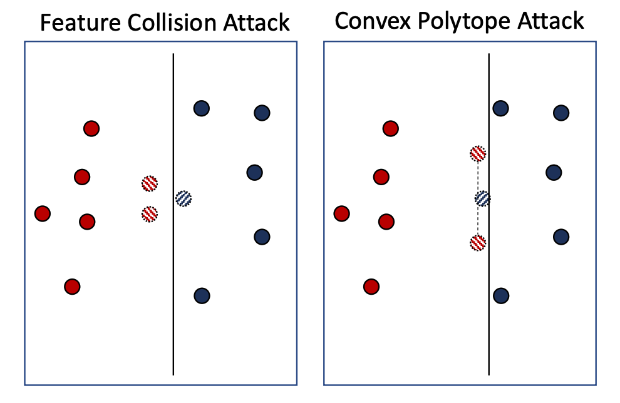
Convex Polytope Attack vs Feature Collision Attack
基于SVM的示例
蓝色毛球：目标样本，不存在与训练集中
红色毛球：包围样本
普通红/蓝点：普通训练样本
Zhu, Chen, et al. “Transferable clean-label poisoning attacks on deep neural nets.” ICML 2019.

Slide 22
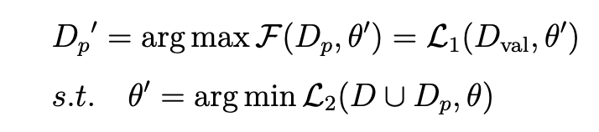
Bi-level Optimization Attack
投毒攻击是一种“双层优化”：投毒完成后，训练模型才能知道其效果
是一个最大-最小化（max-min）问题
内部最小化：在投毒数据上更新模型
外部最大化：在更新后的模型上生成更强的投毒数据
Mei and Zhu. “Using machine teaching to identify optimal training-set attacks on machine learners.” AAAI 2015.

Slide 23
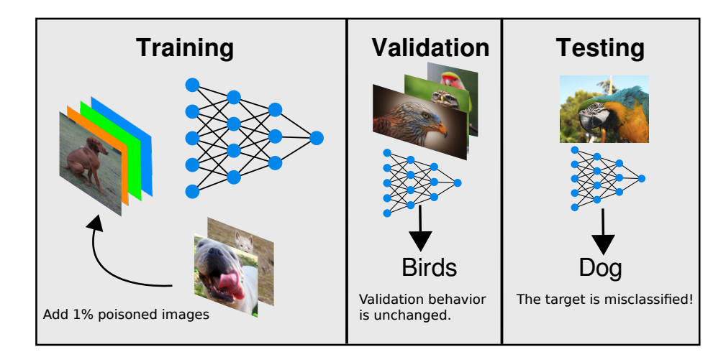
MetaPoison
One advanced bi-level optimization attack
不修改类标
有目标（Targeted攻击）
验证集上的性能不变
使用元学习寻找高效投毒样本
可攻击微调和端到端模型
成功攻击商业模型Google Cloud AutoML API
Huang, W. Ronny, et al. “Metapoison: Practical general-purpose clean-label data poisoning.” NeurIPS 2020.

Slide 24
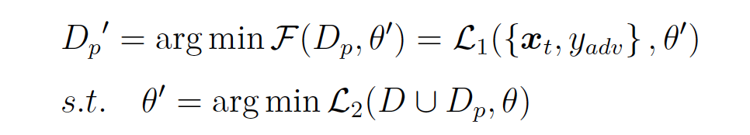
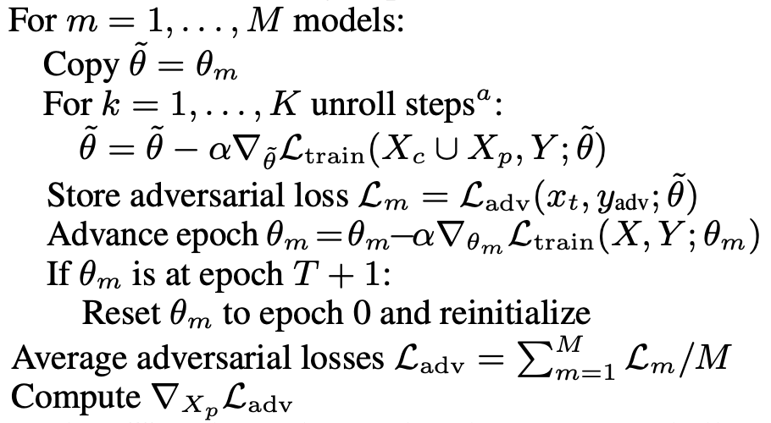
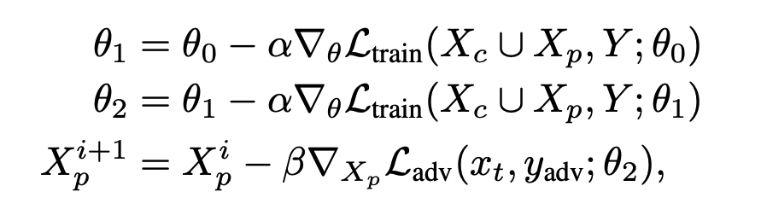
MetaPoison
A Bi-level Min-Min Optimization Attack
K-step 优化策略：
内层多步（’look ahead’），外层一步
使用m个模型和周期性初始化来增加探索
Huang, W. Ronny, et al. “Metapoison: Practical general-purpose clean-label data poisoning.” NeurIPS 2020.

Slide 25
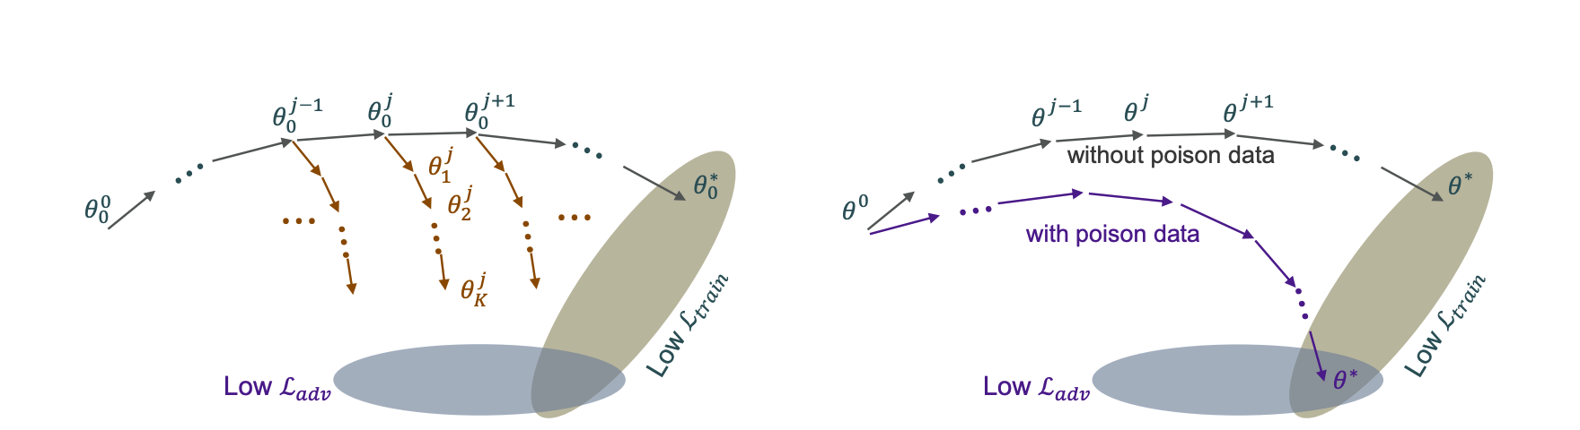
MetaPoison
优化阶段
投毒后影响
Huang, W. Ronny, et al. “Metapoison: Practical general-purpose clean-label data poisoning.” NeurIPS 2020.

Slide 26
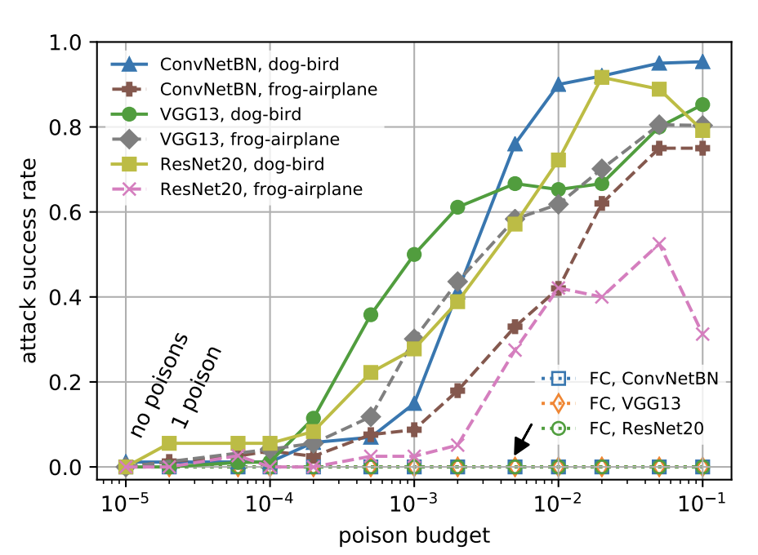
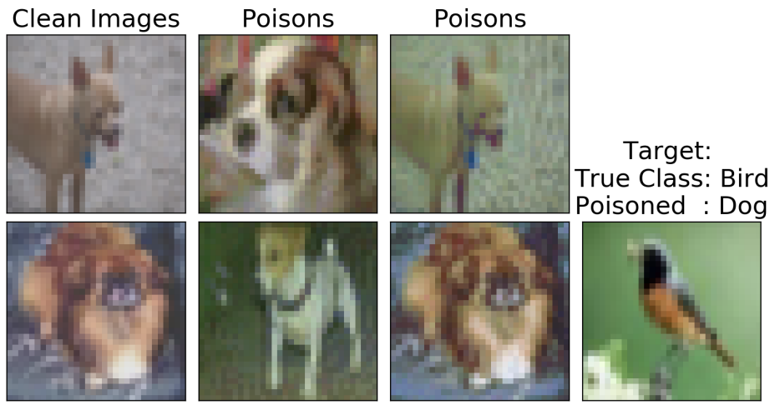
MetaPoison
示例：狗毒化成鸟
毒化0.1%的数据即可达到很高的ASR
Huang, W. Ronny, et al. “Metapoison: Practical general-purpose clean-label data poisoning.” NeurIPS 2020.

Slide 27
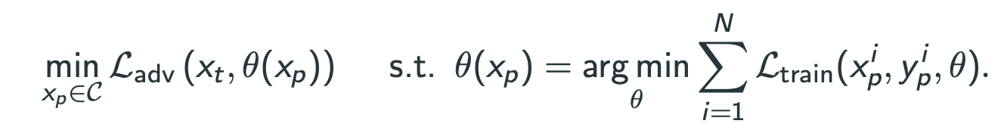
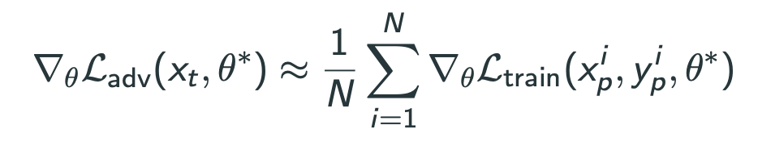
Witches‘ Brew：思想
依然是Min-Min 双层优化问题
Trick：在生成毒化样本时，使其梯度与目标样本一致
直观理解：让毒化样本和目标样本在训练过程中触发同样的梯度，即让毒化样本更像目标样本
Geiping, Jonas, et al. “Witches‘ Brew: Industrial Scale Data Poisoning via Gradient Matching.” ICLR 2021.

Slide 28
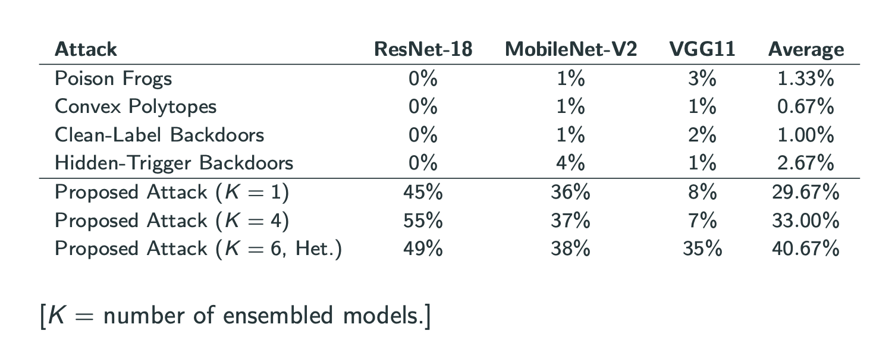
Witches‘ Brew：实验结果
Geiping, Jonas, et al. “Witches‘ Brew: Industrial Scale Data Poisoning via Gradient Matching.” ICLR 2021.

Slide 29
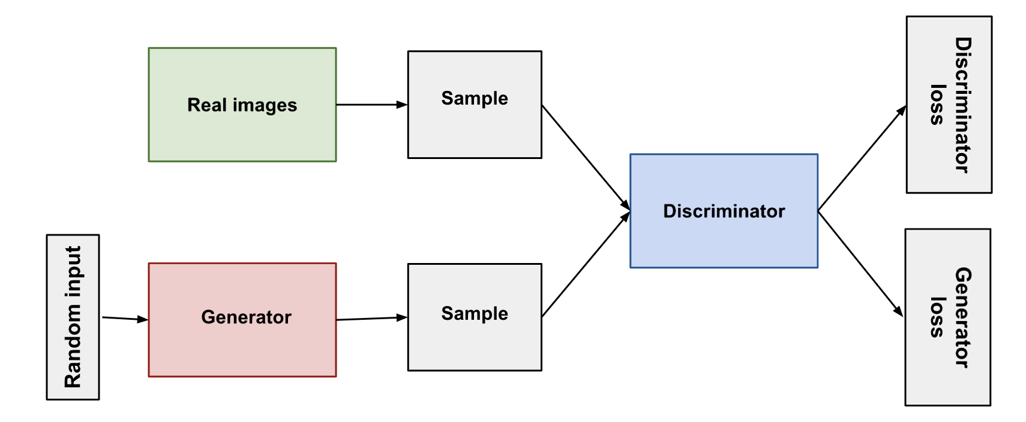
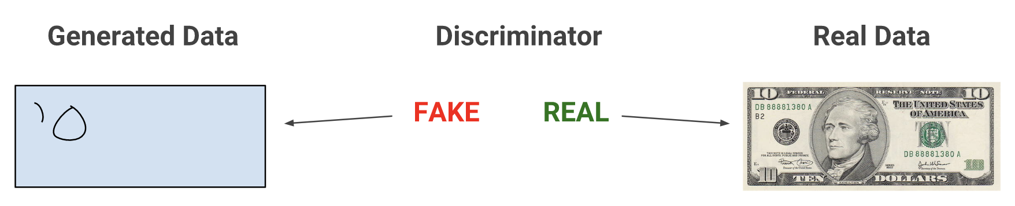
Generative Attack （生成式攻击）
对抗生成网络（GAN）：
一次训练，无限使用
https://developers.google.com/machine-learning/gan/gan_structure

Slide 30
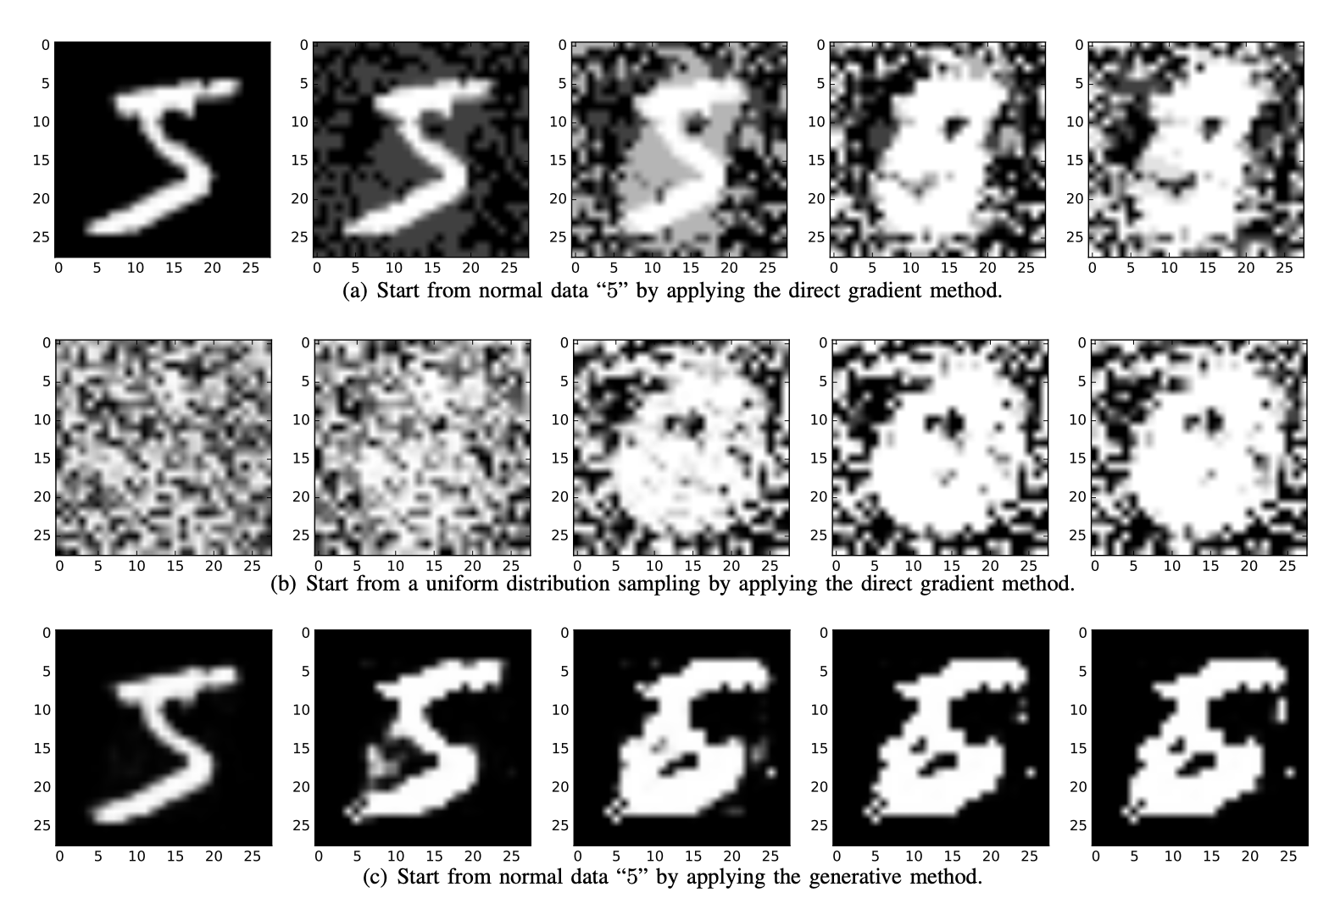
Autoencoder-based Generative Attack
从正常的5开始，使用直接梯度
从随机噪声开始，使用直接梯度
从正产的5开始，使用生成方法
Yang, Chaofei, et al. "Generative poisoning attack method against neural networks." arXiv:1703.01340 (2017).

Slide 31
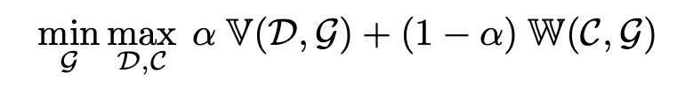
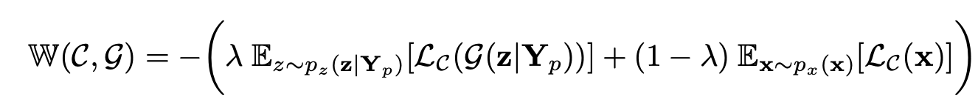
pGAN
涉及三个模型： D（判别器）、G（生成器）、C（分类器）
对抗损失与GAN一样：
分类损失（原始数据+生成数据损失）：
Yang, Chaofei, et al. "Generative poisoning attack method against neural networks." arXiv:1703.01340 (2017).

Slide 32
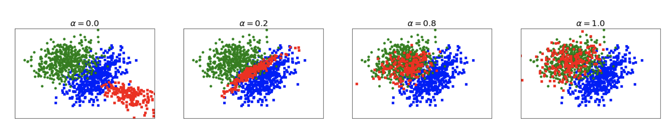
pGAN
可以生成真正靠近目标类的投毒样本
绿色：正常类（目标类），正常样本
蓝色：正常类，正常样本
红色：毒化类，毒化样本
Yang, Chaofei, et al. "Generative poisoning attack method against neural networks." arXiv:1703.01340 (2017).

Slide 33
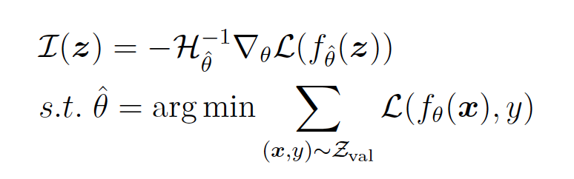
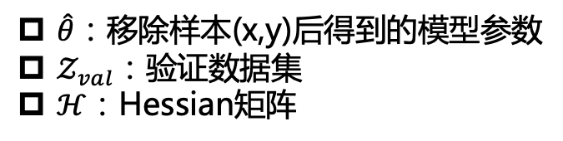
差异化攻击：对哪些样本投毒更有效？
衡量样本影响力的指标：
对影响大的样本投毒
$\hat{θ}：$移除样本(x,y)后得到的模型参数
$𝒵_{val}$：验证数据集
$ℋ$：Hessian矩阵
Koh et al. "Stronger data poisoning attacks break data sanitization defenses." Machine Learning 111.1 (2022): 1-47.

Slide 34
Data Poisoning: Attacks and Defenses
A Brief History of Data Poisoning
Data Poisoning Attacks
Data Poisoning Defenses
Poisoning for Data Protection
Future Research

Slide 35
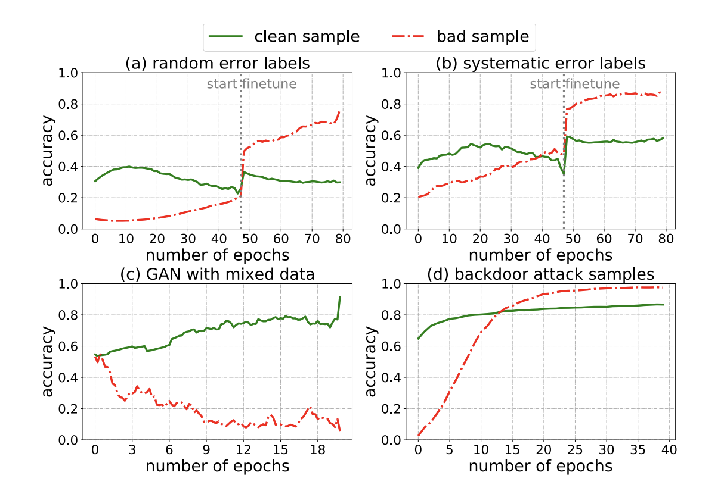
Data Poisoning Defense
Robust Learning with Trimmed Loss
Loss 低的是好样本
Loss高的是坏样本
让模型尽量在Loss低的样本上训练
问题样本：噪声标签、系统噪声、生成模型—+坏数据、后门样本
Shen, Yanyao, and Sujay Sanghavi. “Learning with bad training data via iterative trimmed loss minimization.” ICML 2019

Slide 36
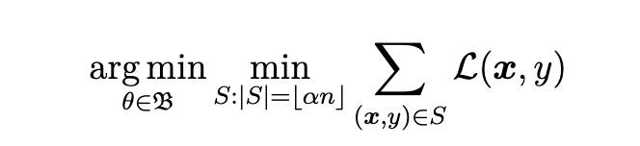
Data Poisoning Defense
Robust Learning with Trimmed Loss
是一个min-min问题
内部最小化：选择低loss的样本子集S
外部最小化：在子集S上训练模型
Shen, Yanyao, and Sujay Sanghavi. “Learning with bad training data via iterative trimmed loss minimization.” ICML 2019

Slide 37
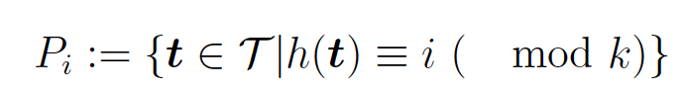
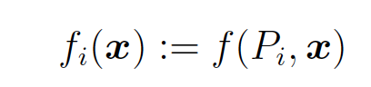
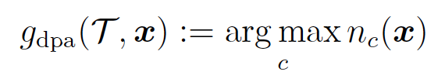
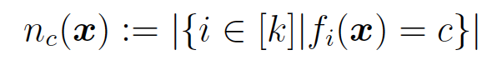
深度划分聚合（Deep Partition Aggregation，DPA）
分而治之：适用于投毒样本比较少的情况
将训练集划分为k个均匀子集：
在每个子集上训练一个基分类器：
投票决策：
Levine, Alexander, and Soheil Feizi. “Deep partition aggregation: Provable defense against general poisoning attacks.” ICLR 2021

Slide 38
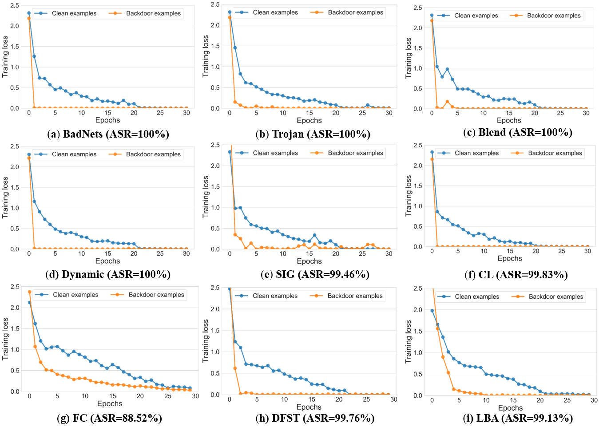
反后门学习（Anti-Backdoor Learning, ABL）
学的快的样本不是好样本
Training loss on Clean samples (blue) VS. Poisoned examples (yellow)
研究10种基于投毒的后门攻击
毒化样本在训练初期就学完了
毒化样本的损失下降很快
Li, Yige, et al. “Anti-backdoor learning: Training clean models on poisoned data.” NeurIPS 2021

Slide 39
反后门学习（Anti-Backdoor Learning, ABL）
先隔离再反学习
Problem Formulation
Overview of ABL
Stage 1: Backdoor Isolation; ($0 ≤t < T_{te}$), t: current epoch; $T_{te}$: turning epoch
Stage 2: Backdoor Unlearning. ($T_{te} ≤t <T$) T: total epoch
LGA: local gradient ascent; GGA: global gradient ascent
Li, Yige, et al. “Anti-backdoor learning: Training clean models on poisoned data.” NeurIPS 2021

Slide 40
Data Poisoning: Attacks and Defenses
A Brief History of Data Poisoning
Data Poisoning Attacks
Data Poisoning Defenses
Poisoning for Data Protection
Future Research

Slide 41

Unlearnable Examples
互联网上充斥着大量的个人数据
https://exposing.ai/megaface/

Slide 42
Personal Data Are Used For Training Commercial Models
Dataset collected from the Internet:
Without awareness [1].
Training commercial models [2].
Privacy concerns [3].
[1] Prabhu & Abeba, "Large image datasets: A pyrrhic win for computer vision?." arXiv:2006.16923, 2020.
[2] Hill Kashmir, “The Secretive Company That Might End Privacy as We Know It.” NY times, 2020.
[3] Shan, Shawn, et al. "Fawkes: Protecting personal privacy against unauthorized deep learning models.” USENIX Security Symposium, 2020

Slide 43
Unlearnable Examples
Goal: making data unlearnable (unusable) to machine learning
Modify Training Images -> Make them Useless
Huang, Hanxun, et al. “Unlearnable examples: Making personal data unexploitable.” ICLR 2021.

Slide 44

Adversarial Noise = Error-maximizing Noise
Adversarial noise can mislead ML models
Adversarial noises are small, imperceptible to human eyes.
Adversarial Examples fool DNN at test time by maximizing errors.
Szegedy et al. 2013, Goodfellow et al. 2014

Slide 45

NO Error to Learn?
Huang, Hanxun, et al. “Unlearnable examples: Making personal data unexploitable.” ICLR 2021.

Slide 46

Generating Error-Minimizing Noise
想要影响模型的训练那一定是一个双层优化问题
$$\underset{θ}{argmin}𝔼_{(x, y)}\min_{δ}{ℓ(f_{θ}\left(x+δ\right), y)} s.t. {\left\|δ\right\|}_{∞}≤ϵ$$
A min-min bi-level optimization objective to find error-minimizing noise $δ.$
Huang, Hanxun, et al. “Unlearnable examples: Making personal data unexploitable.” ICLR 2021.

Slide 47



Sample-wise Noise
每个样本都有一套自己的噪声
+
=
Huang, Hanxun, et al. “Unlearnable examples: Making personal data unexploitable.” ICLR 2021.
Notes:
We have two types of noise.
The sample-wise noise applies to the data individually.

Slide 48



Class-wise Noise
每类样本共享一套噪声
+
=
规律？为什么这一个噪声图案可以让一整类的数据没有了错误？
Huang, Hanxun, et al. “Unlearnable examples: Making personal data unexploitable.” ICLR 2021.

Slide 49


Experiments
Comparison the effect of different noises on training:
Error-Minimizing noise can create unlearnable examples in both settings.
Huang, Hanxun, et al. “Unlearnable examples: Making personal data unexploitable.” ICLR 2021.

Slide 50
Experiments
Is the noise transferable to other models?
Yes
Is the noise transferable to other datasets?
Yes
Is the noise robust to data augmentation?
Yes

Slide 51

Experiments
What percentage of the data needs to be unlearnable?
Unfortunately, it needs 100% training data to be poisoned.

Slide 52

Experiments
How about protecting part of the data or just one class?
Unlearnable Examples will not contribute to model training.

Slide 53

Protecting Face Images
No more facial recognitions?
If everyone post unlearnable images.

Slide 54
Conclusion & Limitations
A new exciting research problem.
Unlearnable Examples.
Error-minimizing noise.
Limitations to representational learning.
Limitations to adversarial training (已被ICLR2022的一篇工作解决: Robust Unlearnable Examples).
Related works:
Cherepanova et al. "LowKey: Leveraging Adversarial Attacks to Protect Social Media Users from Facial Recognition." ICLR, 2021.
Fowl et al. “Adversarial Examples Make Strong Poisons.” NeurIPS 2021.
Fowl et al. "Preventing unauthorized use of proprietary data: Poisoning for secure dataset release." arXiv:2103.02683
Radiya-Dixit and Tramèr. "Data Poisoning Won't Save You From Facial Recognition." arXiv:2106.14851
Shan et al. “Fawkes: Protecting privacy against unauthorized deep learning models.” USENIX Security, 2021

Slide 55

Unlearnable Clusters

Slide 56

Protection Against Unknown Labelling

Slide 57

Existing Approaches
Error-minimizing noise 使模型的训练损失下降到0来让模型觉得“已经没有什么信息可学了”[1]。
Adversarial Poisoning 利用非鲁棒特征[2]这个概念使模型去学习错误的非鲁棒特征[3]。
[1] Unlearnable examples: Making personal data unexploitable, ICLR 2021.
[2] Adversarial Examples Are Not Bugs, They Are Features, NeurIPS 2019.
[3] Adversarial examples make strong poisons, NeurIPS 2021.

Slide 58

Universal Adversarial Perturbation (UAP)
Universal Adversarial Perturbation (UAP) 是指被施加在任一图像上之后都弄愚弄模型的一种class-wise perturbation[1]。
它既可以“覆盖”图像中原本的语义特征，还可以“独立”地工作[2]。
[1] Universal adversarial perturbations, CVPR2017.
[2] ImageNet Pre-training Also Transfers Non-robustness, AAAI2023.

Slide 59

Unlearnable Clusters (UCs)
在不依赖标签信息（分类层）的前提下，实现打破一致性（uniformity）和差异性（discrepancy）

Slide 60


K-means Initial
给定代理模型$f_{s}$,输入干净的数据集$D_{c}$,可以得到特征$E=[e_{1}, …, e_{k}]$, $k是$样本数。
使用K-means将$E$分为$p个$簇：$C=\{C_{1}, …,C_{p}\}$,对应的簇中心${μ_{c}=\{μ}_{C_{1}}, …,μ_{C_{p}}\}$。

Slide 61




Disrupting Discrepancy and Uniformity
先“聚集”再“转圈”。
每一个簇有一个固定的cluster-wise噪声，也就是要生成$p$个噪声。

Slide 62


Methodology

Slide 63

Experiments

Slide 64

Experiments

Slide 65


Experiments
Dataset:37-class Pets
Dataset:37-class Pets

Slide 66

Transferable Unlearnable Examples

Slide 67


Linear Separability
Class-wise perturbations
EMN
Linear Separability
reshape
(32 x 32 x 3) dim = 3072 dim
t-SNE visualization in input space
Availability Attacks Create Shortcuts. Yu, Da et al. , KDD 2022.

Slide 68

Quantifying Linear Separability
Model: Linear model and Two-layer Neural Network
Input x: perturbation
Label y: corresponding label of perturbed image
Availability Attacks Create Shortcuts. Yu, Da et al. , KDD 2022.

Slide 69


Linearly Separable Perturbations
Goal: to show simple linear separability is enough for poisoning.
Synthetic noise (SN):
horse
cat
horse
Availability Attacks Create Shortcuts. Yu, Da et al. , KDD 2022.

Slide 70

Linearly Separable Perturbations
Synthetic noise work the same
Availability Attacks Create Shortcuts. Yu, Da et al. , KDD 2022.

Slide 71
The Problem of Transferability
Lack of transferability
Training-wise transferability: comprehensive protection
Supervised model
Unsupervised model
feature extractor
linear
Cross-Entropy
feature extractor
linear
Unsupervised loss

Slide 72

Problems of Previous Method
Lack of Training-wise transferability
Indiscriminate poisoning attacks on unsupervised contrastive learning. arXiv:2202.

Slide 73


Problems of Previous Method
Lack of Data-wise transferability
Indiscriminate poisoning attacks on unsupervised contrastive learning. arXiv:2202.

Slide 74


Class-wise Separability Discriminant (CSD)
Intra-class distance
Inter-class distance

Slide 75


Class-wise Separability Discriminant (CSD)
Inter-class distance
CSD

Slide 76

Transferable Unlearnable Examples (TUEs)
TUE
Alternative solution

Slide 77
Interpolation for data-wise transferability
Difference between target datasets and non-target datasets
Different number of samples in one class
Different number of classes
More samples in one class:
More classes:
Dataset | Num of Class | Sample in each class
CIFAR10 | 10 | 5000
CIFAR100 | 100 | 500
SVHN | 10 | 4000~7000

Slide 78


Interpolation for data-wise transferability
Visualization:

Slide 79

Experiments
Training-wise transferability

Slide 80


Experiments
Data-wise transferability

Slide 81
谢谢！

